Slide 1
Zurich
Double Lock-In
Lee Jong Geon

Slide 2
Last Points
External reference signal input
AUX: Auxiliary
20kHz Bandwidth, 400kSamples/s
Analog signal
DIO: Digital Input/output
2MHz Bandwidth
TTL signal → for external reference and triggering
166 ns delay between sync on DIO and front panel
➔ AUX를 external reference signal input으로 사용

Slide 3
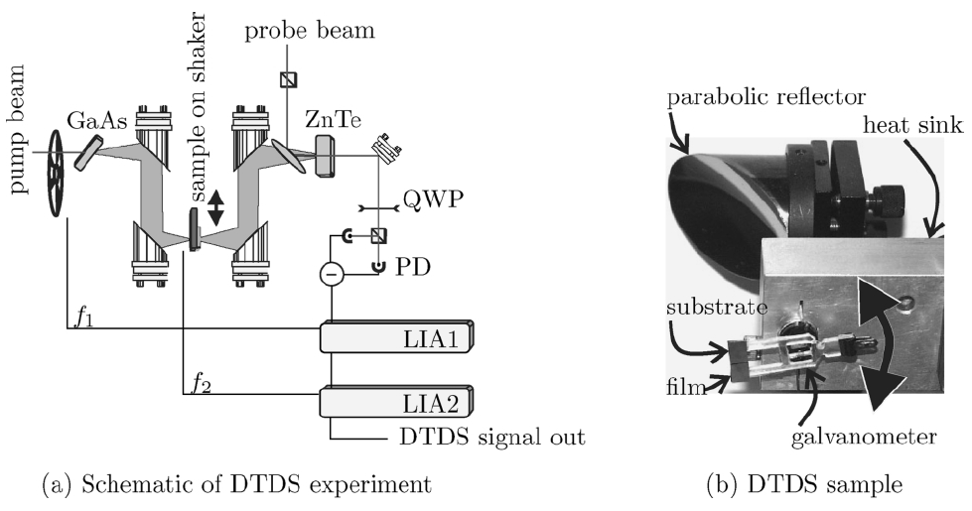
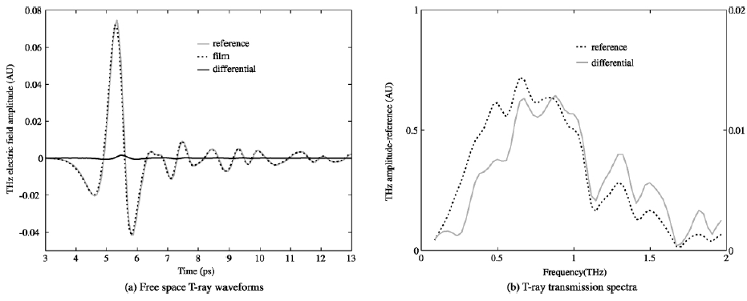
Double Lock-In
“Double modulated differential THz-TDS for thin film dielectric characterization”
Mickan, S. P.; Lee, K.-S.; Lu, T.-M.; Munch, J.; Abbott, D.; Zhang, X.-C. Microelectronics Journal 2002, 33 (12), 1033–1042.

Slide 4
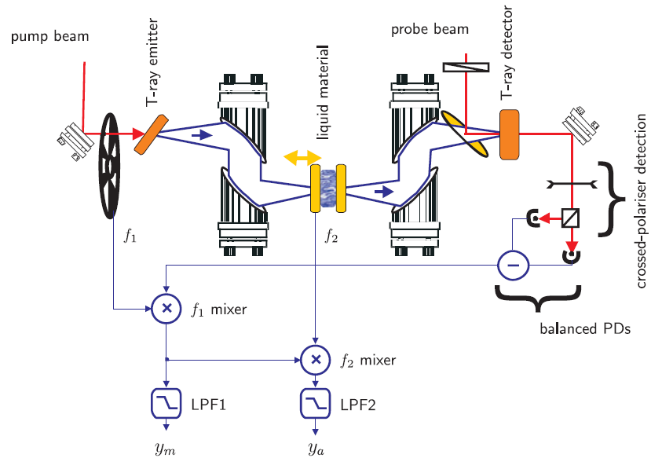
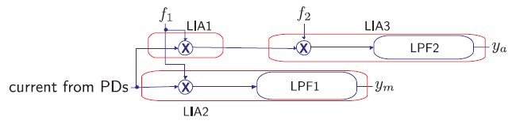
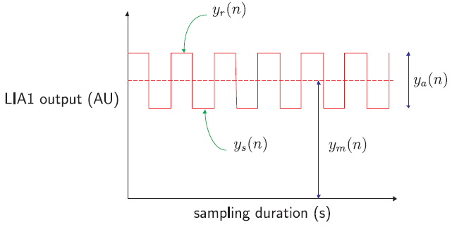
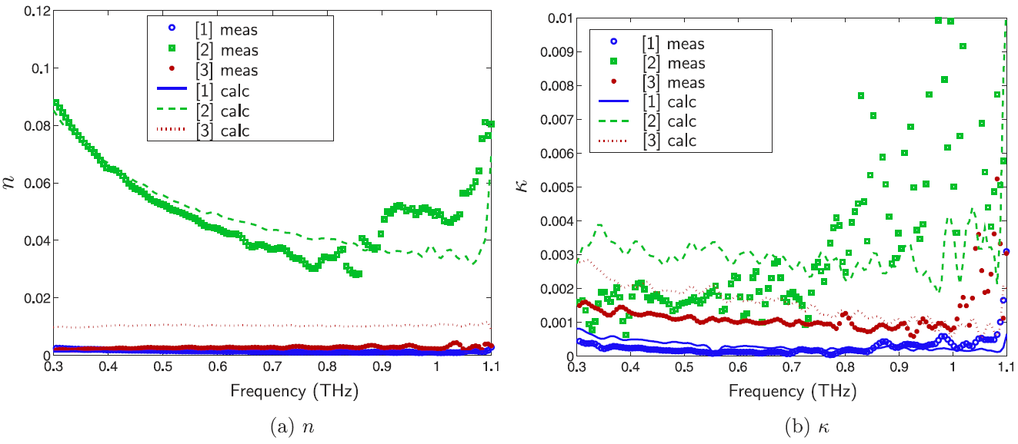
Double Lock-In
“Low noise laser-based T-ray spectroscopy of liquids using double-modulated differential time-domain spectroscopy”
⬅ Uncertainty graph
➔ Focus on double modulation system
Mickan, S. P.; Shvartsman, R.; Munch, J.; Zhang, X.-C.; Abbott, D. Journal of Optics B: Quantum and Semiclassical Optics 2004, 6 (8).

Slide 5
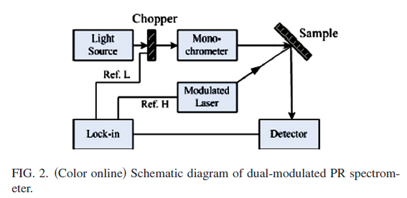
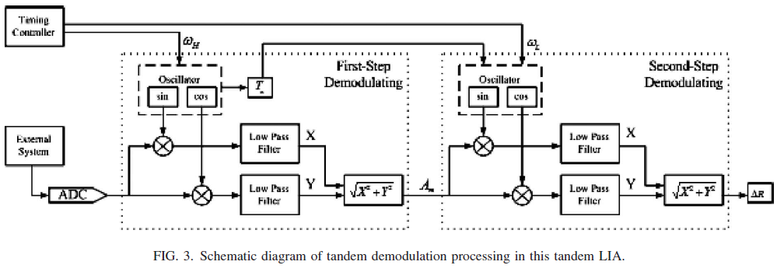
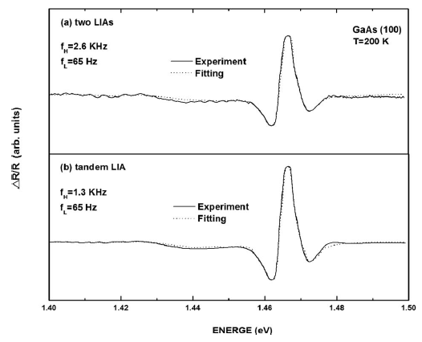
Double Lock-In
“Tandem demodulation lock-in amplifier based on digital signal processor for dual-modulated spectroscopy”
1st
2nd
SNR=20
독립된 LIA 2개를 Series로 연결하는 것보다, Tandem LIA를 구성하는 것이 SNR에서 이득
SNR=31
*SNR = (maximum peak value)/(maximum background noise)
Qin, J.; Huang, Z.; Ge, Y.; Hou, Y.; Chu, J. Review of Scientific Instruments 2009, 80 (3), 033112.

Slide 6
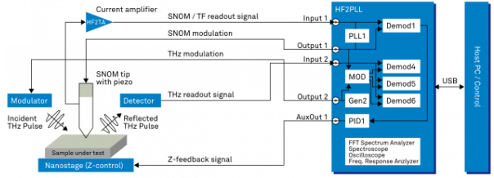
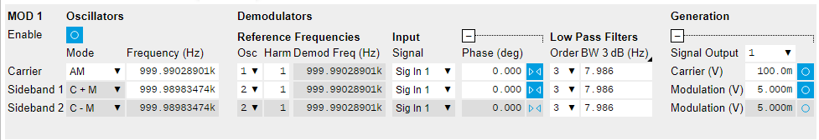
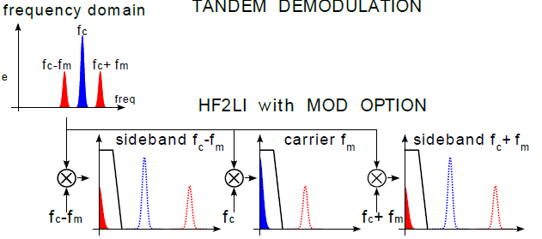
Design
Zurich Instrument - Applications
THz Scanning Near-field Microscopy (SNOM) https://www.zhinst.com/applications/scanningprobe/thz-snom (accessed Jun 18, 2018).

Slide 7
Week Plan
Zurich double lock in
Diagram 바탕으로 MOD function을 활용하여 LabVIEW 프로그램 작성

